Slide 1
SCHOOL OF ENGINEERING, ELECTRICAL AND ELECTRONIC ENGINEERING
NETWORKS 4_ Week B_
Ronald van Buuren
April 2023

Slide 2
net4 program by week
1st order RC networks – discharging – DC source
1st order RC networks – charging – DC source
RL networks – Steady-state DC
RL networks – Switched DC source
RC & RL networks – complementary solution
<spare week>
Exam Wrapup

Slide 3
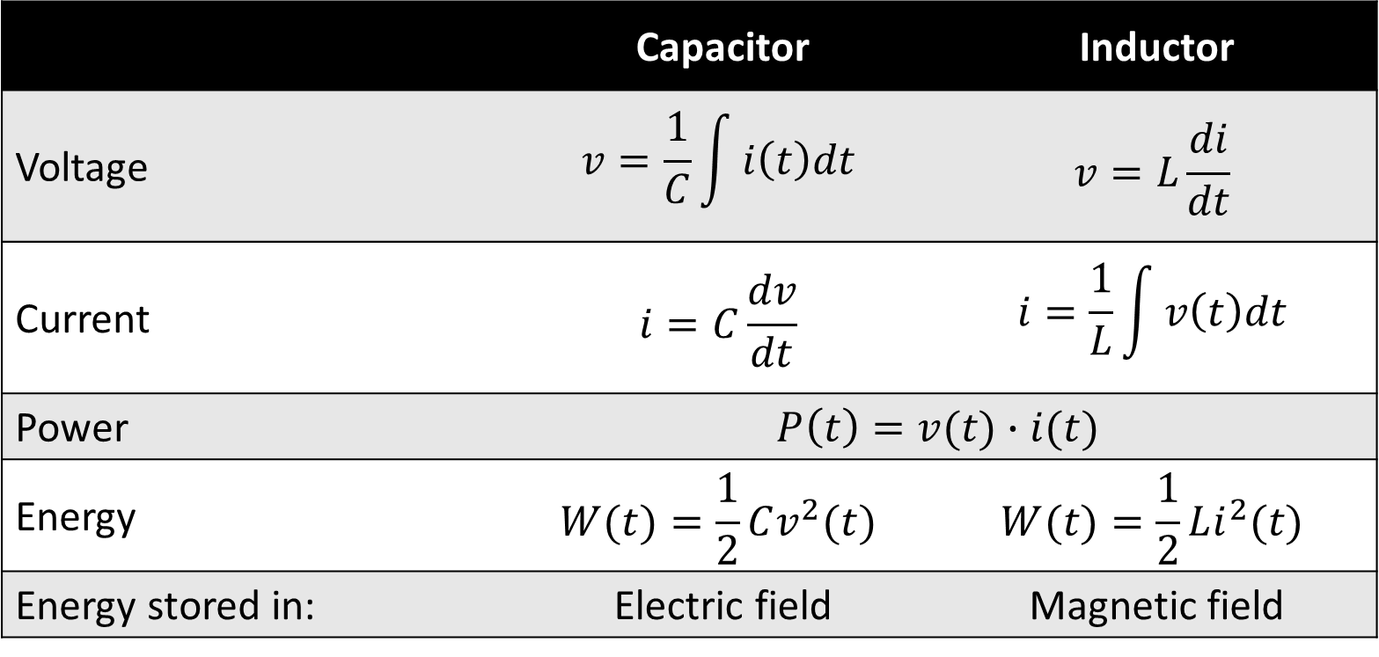
week a: Capacitor & inductor
 | Capacitor | Inductor
Voltage | $$v=\frac{1}{C}\int{i\left(t\right)dt}$$ | $$v=L\frac{di}{dt}$$
Current | $$i=C\frac{dv}{dt}$$ | $$i=\frac{1}{L}\int{v\left(t\right)dt}$$
Power | $$P\left(t\right)=v(t)∙i(t)$$
Energy | $$W(t)=\frac{1}{2}Cv^{2}(t)$$ | $$W(t)=\frac{1}{2}Li^{2}(t)$$
Energy stored in: | Electric field | Magnetic field

Slide 4
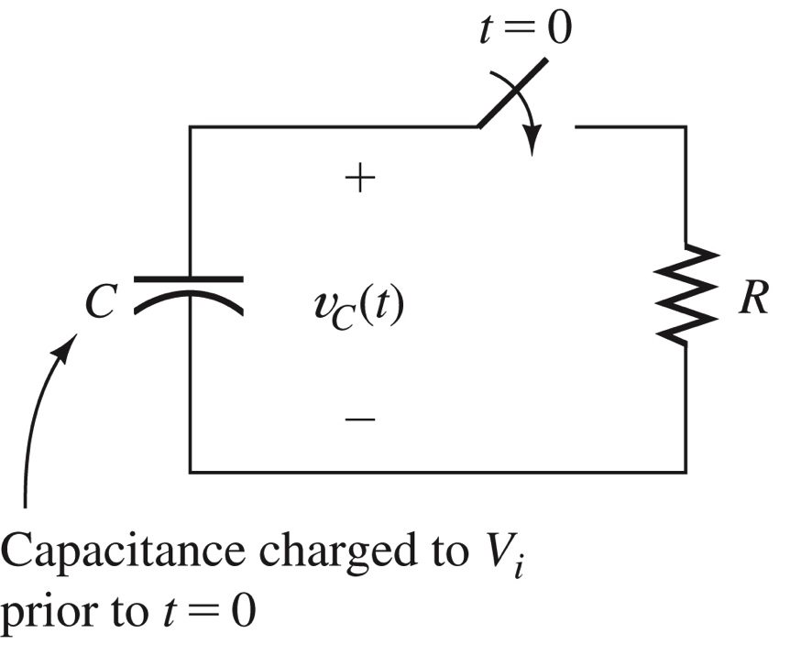
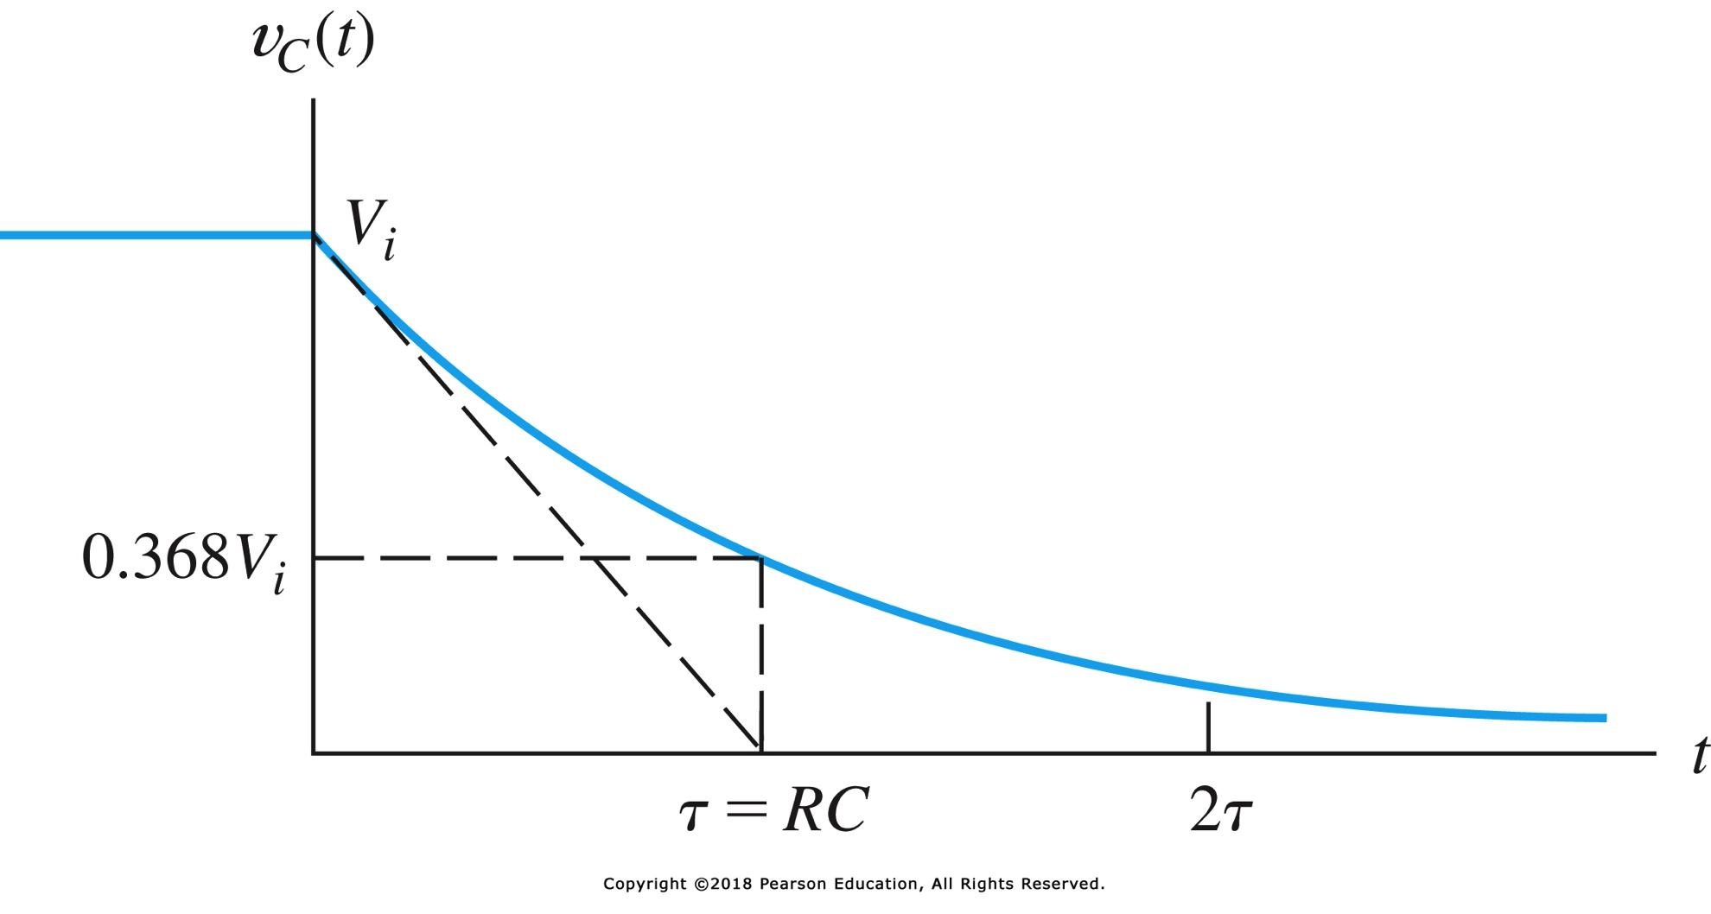
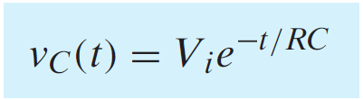
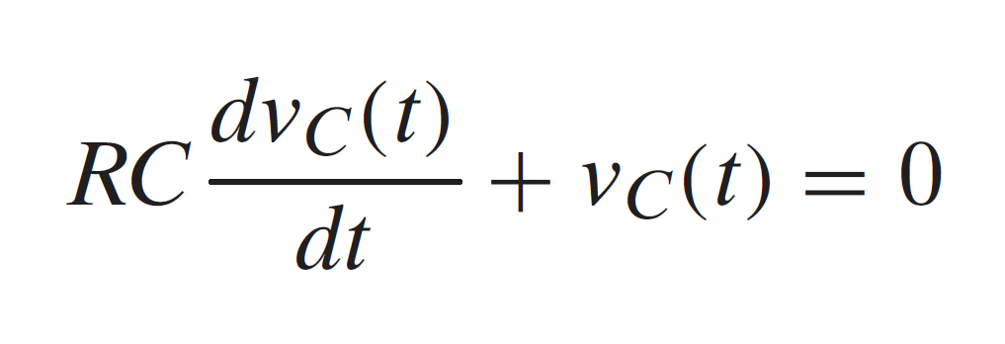

week a: Discharging a capacitor

Slide 5
this week
1st order networks with a fixed DC source
Charging a capacitor

Slide 6
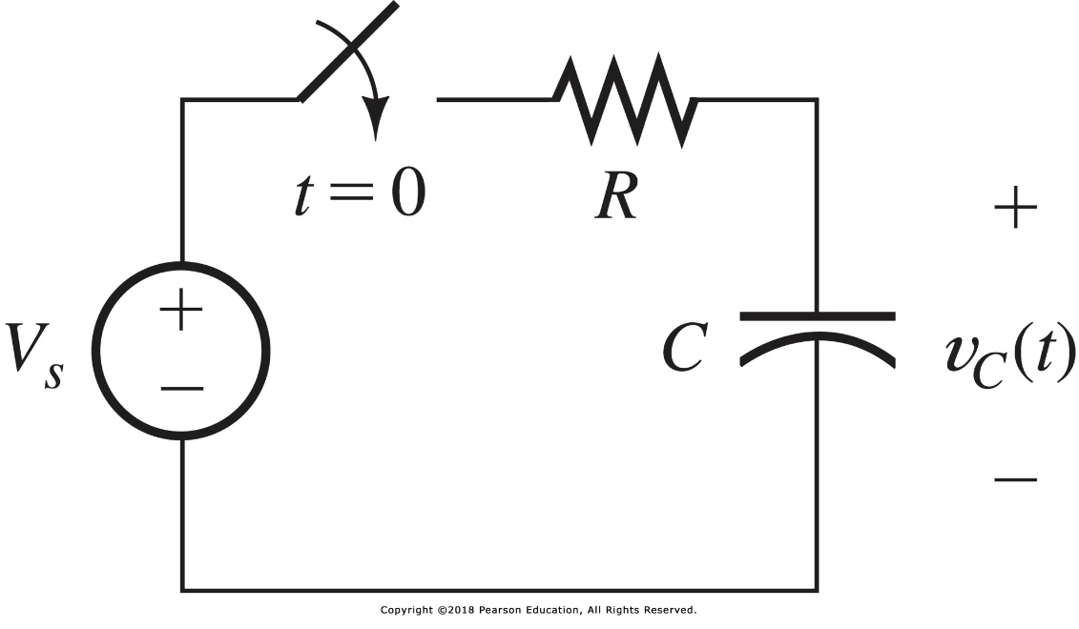
Charging a capacitor

Slide 7
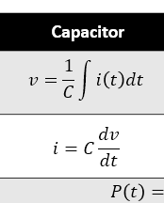

Charging a capacitor: KCL
KCL:
sum of currents = 0

Slide 8

Charging a capacitor: KCL
Educated guess v_{C}=K₁+K₂e^{st}

Slide 9
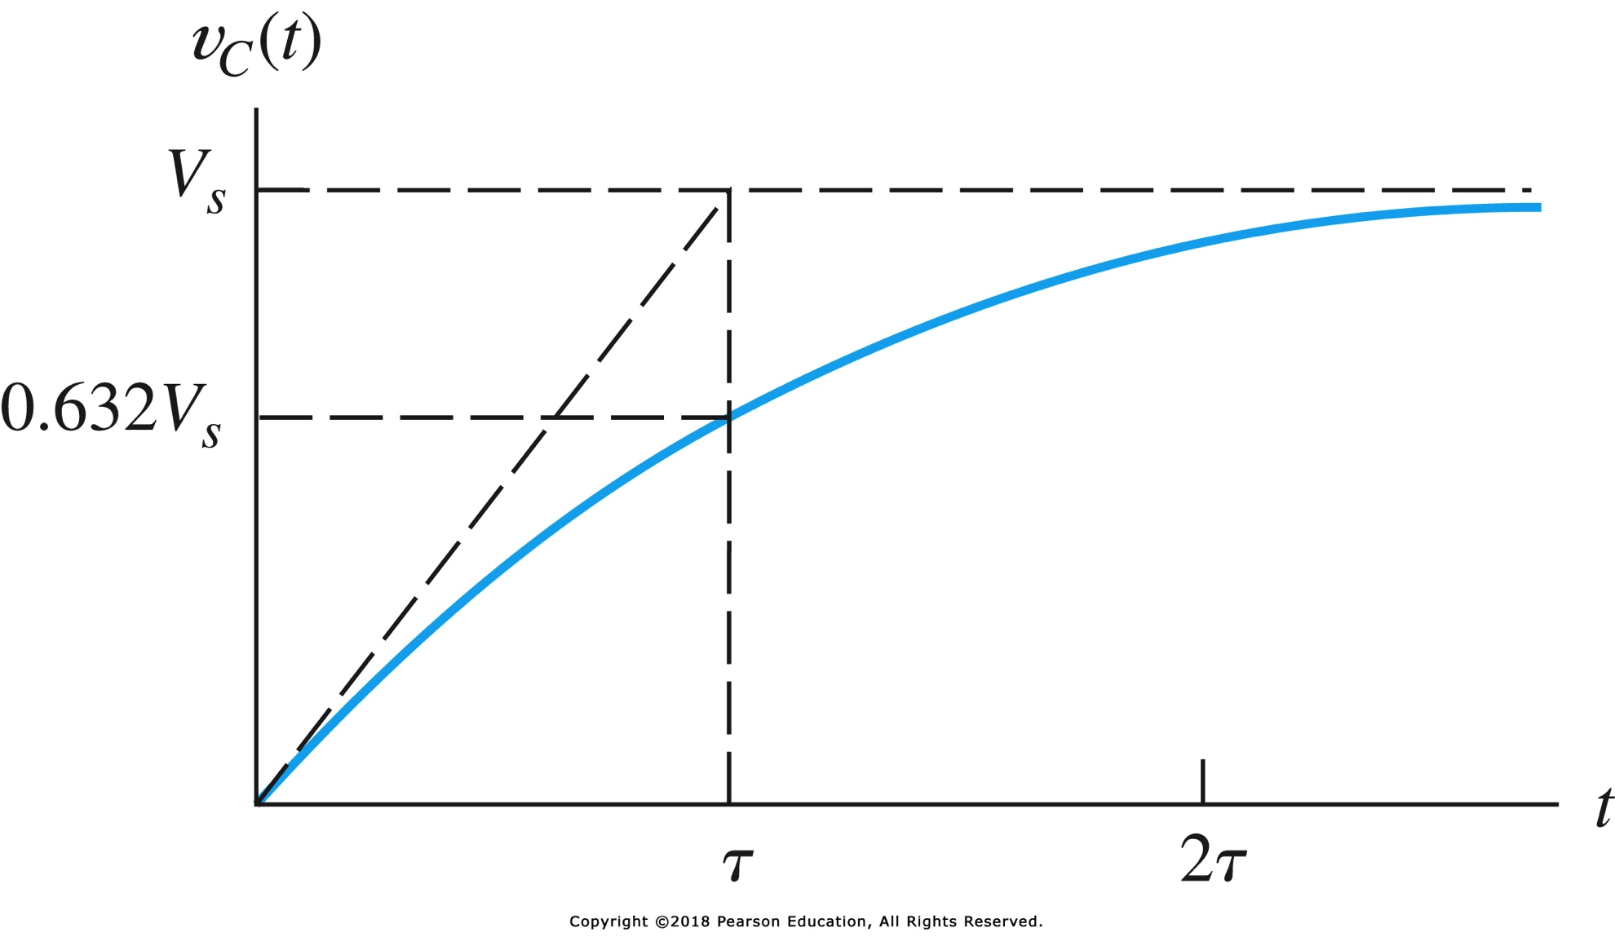
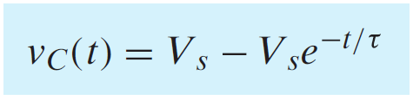
Charging a capacitor

Slide 10
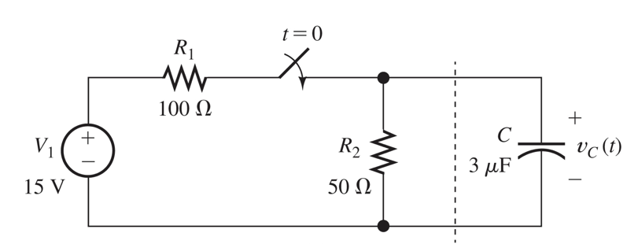
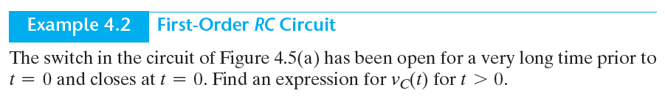
Example 4.2

Slide 11
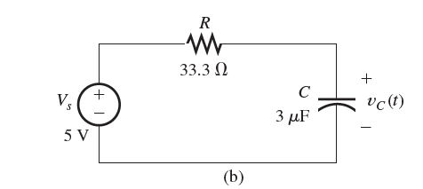
example 4.2 solution
Thévenin equivalent
KCL – or rather, realize that this is a standard 1st order RC circuit in CHARGING mode

Slide 12
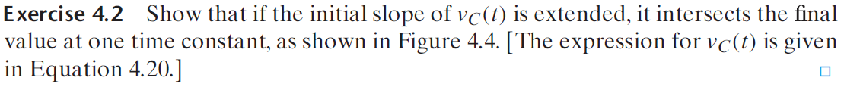

Exercise

Slide 13
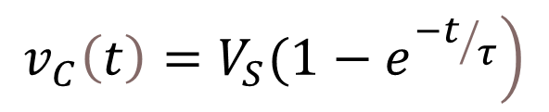

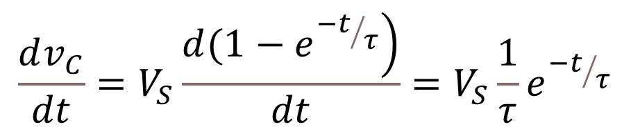
exercise 4.2 – solution step 1
$$\left.v_{C}\left(t\right)=V_{S}(1−e^{{−t}/τ}\right)$$
$$\frac{dv_{C}}{dt}=V_{S}\frac{\left.d(1−e^{{−t}/τ}\right)}{dt}=V_{S}\frac{1}{τ}e^{{−t}/τ}$$
slope:
so, at t=0: slope =
$$\frac{V_{S}}{τ}$$

Slide 14
problems
P4.3
P4.8
P4.13
P4.14
P4.17
P4.18

